Slide 1



HealthApplication™
V2.0 Team Presentation
Team 1A Dakota
Daniel McKee, Kyle Weishaar, Leeon Noun, Luke Picciano, Sahand Nowshiravani
Notes:
Daniel

Slide 2
Outline
- System Design
Model
Controller
View
- The Good
- The Bad
- Demo
- Questions
Notes:
Daniel

Slide 3
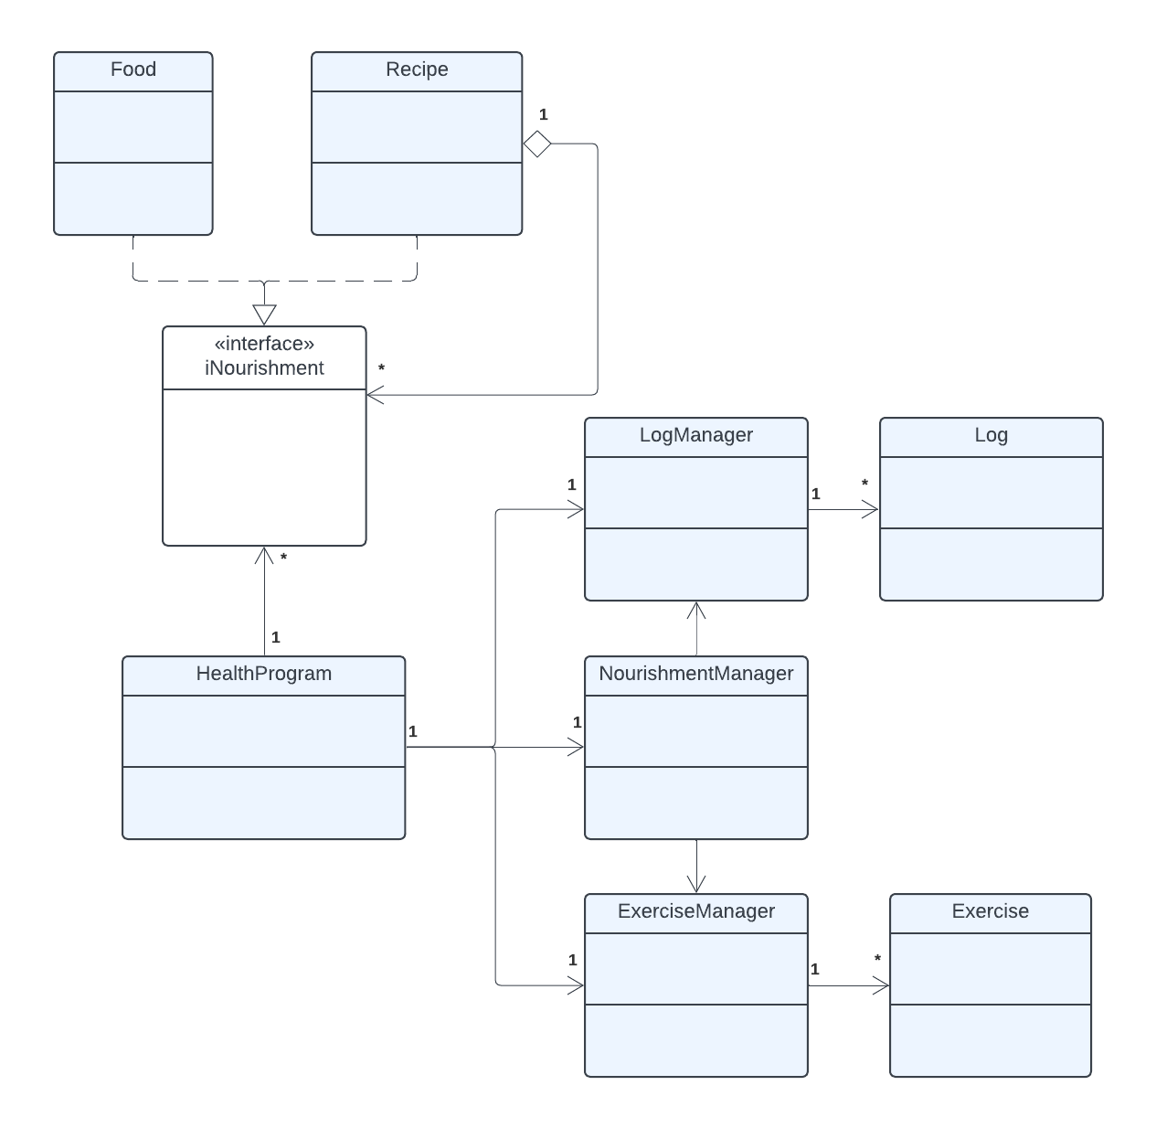
System Design - Model
Stores and manages all data
Handles food, exercise, and log information
Calculates daily nutrition stats
Keeps data consistent for the whole app
Notes:
Daniel

Slide 4
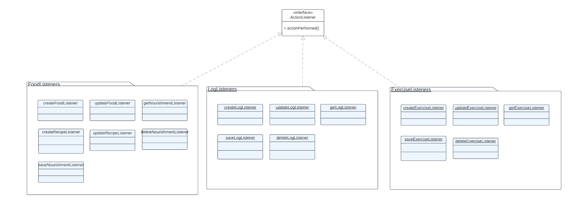
System Design - Controller
High Granularity, High Separations of Concerns
Notes:
Luke
So of course for this project we will be using a composite pattern in our development to help organize food logs. Composite patterns are ideal for cases where we are out to represent hierarchies of objects, such as things like individual foods and entire recipes.
The component in our design is the iNourishment interface. iNourishment acts as the foundational piece that unifies both individual Food items and Recipe groups by defining a shared set of methods. This interface specifies the basic methods that all iNourishment objects need, like getCalories(), getFat(), and getProtein(). Because both Food and Recipe implement iNourishment, they can be treated in the same way, regardless of whether they're simple items or complex recipes. This allows our code to handle both types of objects in a consistent manner, making it easy to build flexible, hierarchical structures.
In this pattern, the leaf is the Food class, and the composite is the Recipe class. The Food class represents individual items, such as a banana, with attributes for calories, fat, carbs, protein, and sodium. The Recipe class, on the other hand, acts as a composite by holding a list of iNourishment items, which could include individual Food objects or even other Recipe objects. This means we can represent complex meals, like a sandwich made of multiple ingredients, as a single Recipe that can then be nested within other recipes if needed.
By using the Composite pattern, we treat both Food and Recipe classes as iNourishment, making it easy to calculate total nutritional values at any level. For example, when logging a recipe with multiple ingredients, Recipe calculates its total calories and nutritional values by summing up each ingredient's values. This approach keeps our code organized and adaptable, so users can log both individual items and recipes seamlessly, reflecting their real-world dietary habits.

Slide 5
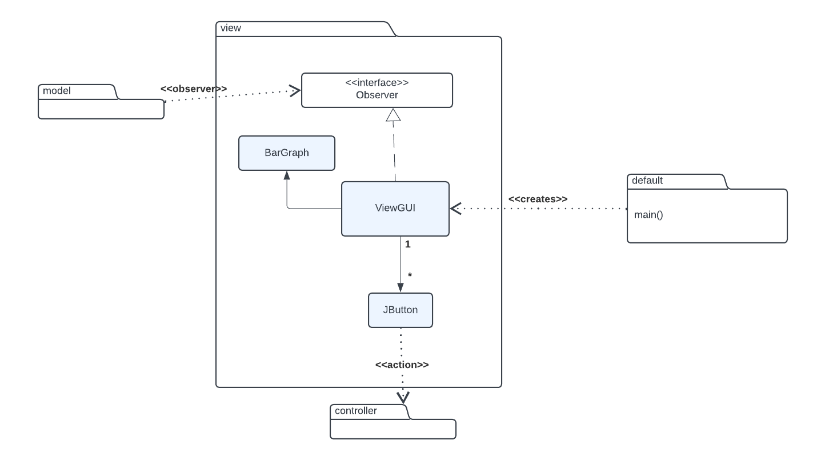
System Design - View
Notes:
Kyle

Slide 6
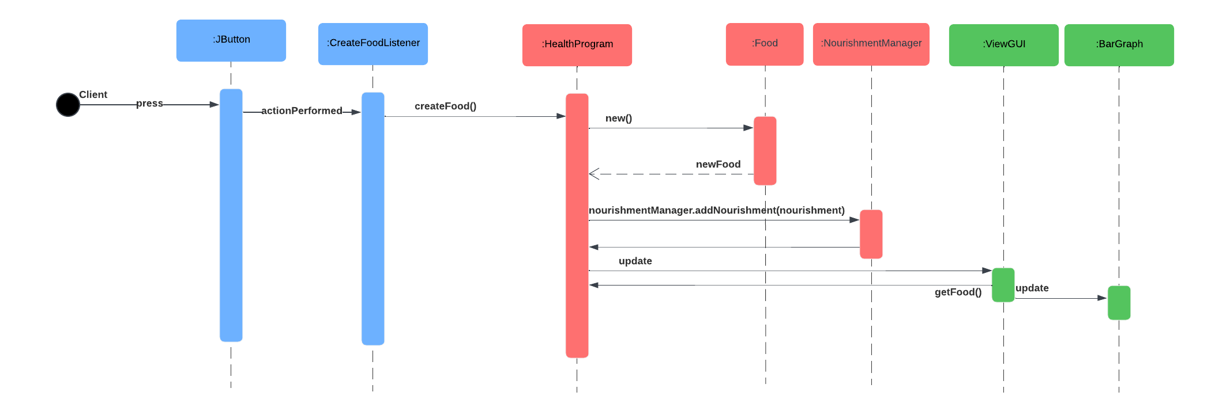
Create a Food
Controller
Model
View
Notes:
Kyle

Slide 7
The GOOD
Demo as expected to present
Comment on some of the methods
Few minors bugs problem
standardized stylistic convention
Solving Class Problem
Better team communication
Notes:
Sahand
Our First challenge was completing Design Document, we struggled by deciding which was need require and the most challenge we struggle was Sequence Diagram, MVC, Composite, Observer Pattern and Subsystem. Those are the challenge we had and didn’t had enough information to start until we took a look at some of the team during the class time and look on their design documents and gave us idea. We perfectly did create a good Subsystem structure, all of class program, pattern usage and MVC, Composite and Observer Pattern and successfully did good sequence diagram but we should be careful next time by cropping the sequence diagram picture and put on design document more professionally. Overall We successfully did it and was great. REVISE -> I’m Design Coordinator for team dakota -> Our first challenge was completing the Design Document; we struggled to decide which section was necessary, and the most challenging area we struggled with was Sequence Diagram, MVC. We had a decent understanding of what we needed to implement, but when we worked with the other groups in our class, they gave us a better understanding of the requirements of the Design Document and it’s sequence diagrams. On top of that, it also showed us how other people implemented their Model View Controller architecture. We hoped the sequence diagram would be easy. However, it wasn't as easy, so we decided to assign two members on a sequence diagram. We created an excellent Subsystem structure, all of the class program, pattern usage, Composite, and Observer Patterns. Overall, We were able to overcome Design Document challenge, and it was great. Our 2nd biggest challenge was Skeleton. We had some problems with our code at first and we had to make sure all of the value was consistent and sense to match the design document. We had team meeting and reassure the code was perfectly make sense and we successfully was able to build skeleton without any problem We had a decent understanding of what we needed to implement, but when we worked with the other groups in our class, they gave us a better understanding of the requirements of the Design Document and it’s sequence diagrams. On top of that, it also showed us how other people implemented their Model View Controller architecture. We hoped the sequence diagram would be easy. However, it wasn't as easy, so we decided to assign two members on a sequence diagram. GOOD STUFF FOR VERSION 2 -> The demo came out in good result and was surprising in positive view and had some of the bug problems. We decided to comment some of the methods to ensure the steps and planning structure was very clear.
Our Structure Stylistic convention came out really positive where we put the effort by making sure our code is readable and understandable.
Lastly, we decided and solve the class problem where we had one UserData who was doing the whole work by doing Nourishment,Exercise, and Log managers, Until we realize it would cause so much problematic so we decided to create three separate class as Nourishment, Exercise and Log Managers.

Slide 8
The BAD
Coding structure
Merge conflict
Lot of trial and error to make the GUI look less cluttered and connect it to controllers
Refactoring our old code to feedback standards
Issues getting the bar graph to work
Rushing to get Exercise implemented and working properly
Thanksgiving break was more impactful than predicted
Notes:
Leeon We faced many challenges throughout this project. Our code initially had overlapping responsibilities, which caused confusion when debugging. To address this, we revised our code structure by reorganizing and splitting the userdata class, which which initially contained everything, into three separate manager classes. We used Git for version control, but conflicts frequently emerged during push and pull requests. Resolving these conflicts required careful coordination and attention to detail. Designing the GUI was another difficult task. We went through numerous trial-and-error iterations to make the interface less cluttered and properly connected to the controllers. Understanding how to make it function as intended was time-consuming and required significant effort. Refactoring our code based on feedback proved to be even more challenging. It often introduced new bugs, regardless of frequent testing. For instance, we had to repeatedly test the controllers against the GUI in the second version after initially focusing on the CLI in the first version. The bar graph implementation was another significant hurdle. We spent a lot of time figuring out how to properly represent data, such as percentages and total nutrient amounts in grams or milligrams. Finally, we had to rush to implement the exercise feature, which was the last part of the project.This process involved combining multiple functions and handling complex calculations, including mathematical operations, which added to the difficulty. These issues significantly impacted our tasks and required persistent effort to address.

Slide 9
Project Recap
- System Design
Model
Controller
View
- The Good
- The Bad

Slide 10

Demo!

